Slide 1
William Stallings
Computer Organization and Architecture
6th Edition
Chapter 8
Operating System Support

Slide 2
Objectives and Functions
Convenience
  Making the computer easier to use
Efficiency
  Allowing better use of computer resources

Slide 3
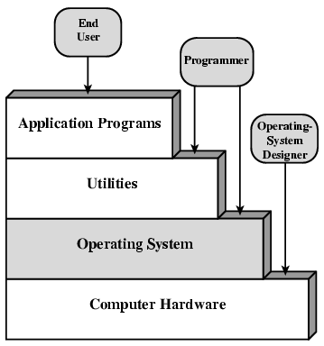
Layers and Views of a Computer System

Slide 4
Operating System Services
Program creation
Program execution
Access to I/O devices
Controlled access to files
System access
Error detection and response
Accounting

Slide 5
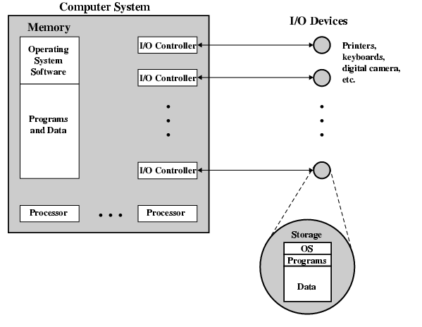
O/S as a Resource Manager

Slide 6
Types of Operating System
Interactive
Batch
Single program (Uni-programming)
Multi-programming (Multi-tasking)

Slide 7
Early Systems
Late 1940s to mid 1950s
No Operating System
Programs interact directly with hardware
Two main problems:
  Scheduling
  Setup time

Slide 8
Simple Batch Systems
Resident Monitor program
Users submit jobs to operator
Operator batches jobs
Monitor controls sequence of events to process batch
When one job is finished, control returns to Monitor which reads next job
Monitor handles scheduling

Slide 9
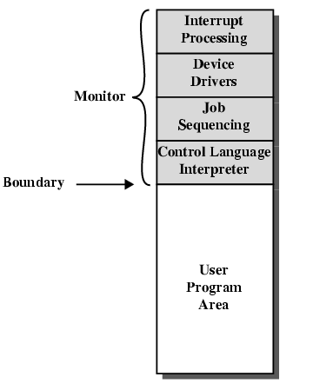
Memory Layout for Resident Monitor

Slide 10
Job Control Language
Instructions to Monitor
Usually denoted by $
e.g.
  $JOB
  $FTN
  ... Some Fortran instructions
  $LOAD
  $RUN
  ... Some data
  $END

Slide 11
Desirable Hardware Features
Memory protection
  To protect the Monitor
Timer
  To prevent a job monopolizing the system
Privileged instructions
  Only executed by Monitor
  e.g. I/O
Interrupts
  Allows for relinquishing and regaining control

Slide 12
Multi-programmed Batch Systems
I/O devices very slow
When one program is waiting for I/O, another can use the CPU

Slide 13
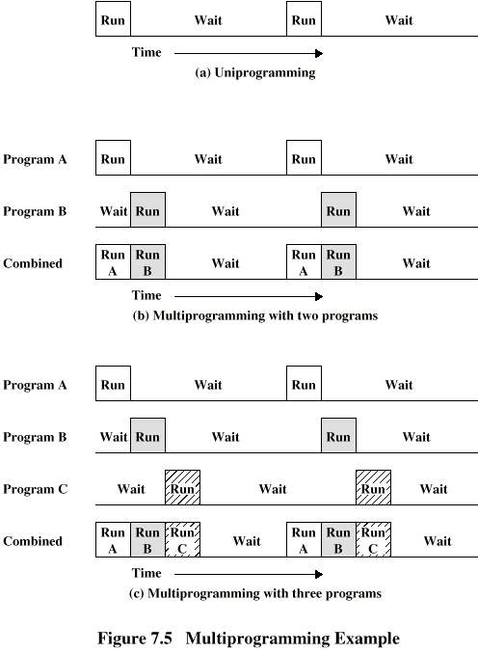
Single Program

Slide 14
Multi-Programming with
Two Programs

Slide 15
Multi-Programming with
Three Programs

Slide 16
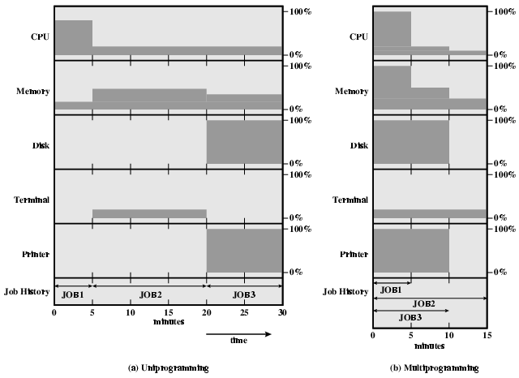
Utilization

Slide 17
Time Sharing Systems
Allow users to interact directly with the computer
  i.e. Interactive
Multi-programming allows a number of users to interact with the computer

Slide 18
Scheduling
Key to multi-programming
Long term
Medium term
Short term
I/O

Slide 19
Long Term Scheduling
Determines which programs are submitted for processing
i.e. controls the degree of multi-programming
Once submitted, a job becomes a process for the short term scheduler
(or it becomes a swapped out job for the medium term scheduler)

Slide 20
Medium Term Scheduling
Part of the swapping function (later…)
Usually based on the need to manage multi-programming
If no virtual memory, memory management is also an issue

Slide 21
Short Term Scheduler
Dispatcher
Fine grained decisions of which job to execute next
i.e. which job actually gets to use the processor in the next time slot

Slide 22
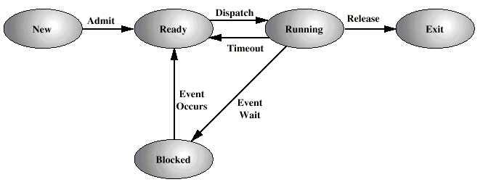
Process States

Slide 23
Process Control Block
Identifier
State
Priority
Program counter
Memory pointers
Context data
I/O status
Accounting information

Slide 24
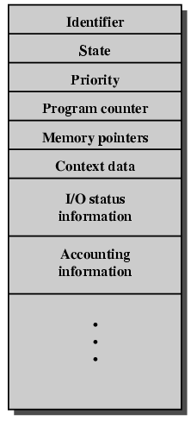
PCB Diagram

Slide 25
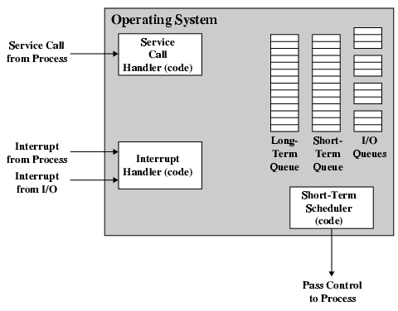
Key Elements of O/S

Slide 26
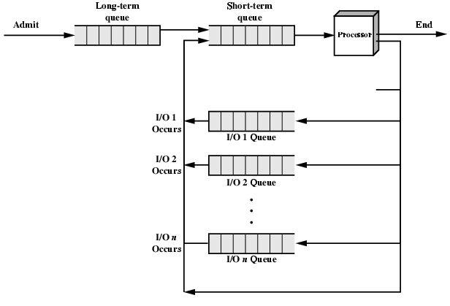
Process Scheduling

Slide 27
Memory Management
Uni-program
  Memory split into two
  One for Operating System (monitor)
  One for currently executing program
Multi-program
  “User” part is sub-divided and shared among active processes

Slide 28
Swapping
Problem: I/O is so slow compared with CPU that even in multi-programming system, CPU can be idle most of the time
Solutions:
  Increase main memory
    Expensive
    Leads to larger programs
  Swapping

Slide 29
What is Swapping?
Long term queue of processes stored on disk
Processes “swapped” in as space becomes available
As a process completes it is moved out of main memory
If none of the processes in memory are ready (i.e. all I/O blocked)
  Swap out a blocked process to intermediate queue
  Swap in a ready process or a new process
  But swapping is an I/O process...

Slide 30
Partitioning
Splitting memory into sections to allocate to processes (including Operating System)
Fixed-sized partitions
  May not be equal size
  Process is fitted into smallest hole that will take it (best fit)
  Some wasted memory
  Leads to variable sized partitions

Slide 31
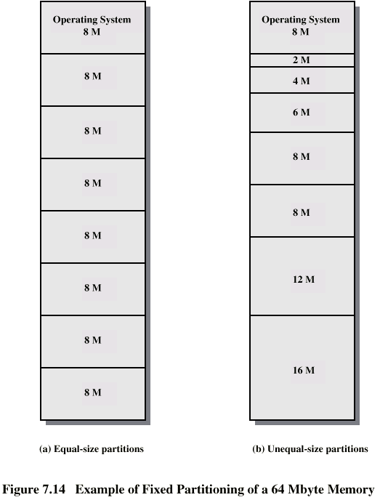
Fixed
Partitioning

Slide 32
Variable Sized Partitions (1)
Allocate exactly the required memory to a process
This leads to a hole at the end of memory, too small to use
  Only one small hole - less waste
When all processes are blocked, swap out a process and bring in another
New process may be smaller than swapped out process
Another hole

Slide 33
Variable Sized Partitions (2)
Eventually have lots of holes (fragmentation)
Solutions:
  Coalesce - Join adjacent holes into one large hole
  Compaction - From time to time go through memory and move all hole into one free block (c.f. disk de-fragmentation)

Slide 34
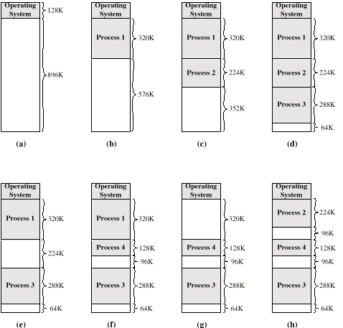
Effect of Dynamic Partitioning

Slide 35
Relocation
No guarantee that process will load into the same place in memory
Instructions contain addresses
  Locations of data
  Addresses for instructions (branching)
Logical address - relative to beginning of program
Physical address - actual location in memory (this time)
Automatic conversion using base address

Slide 36
Paging
Split memory into equal sized, small chunks -page frames
Split programs (processes) into equal sized small chunks - pages
Allocate the required number page frames to a process
Operating System maintains list of free frames
A process does not require contiguous page frames
Use page table to keep track

Slide 37
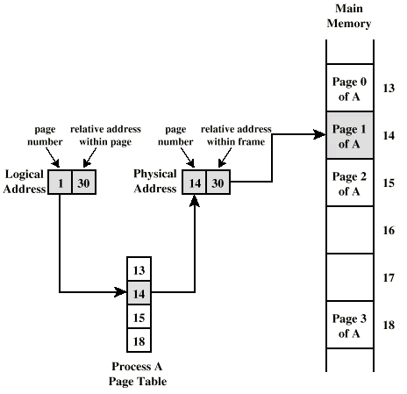
Logical and Physical Addresses - Paging

Slide 38
Virtual Memory
Demand paging
  Do not require all pages of a process in memory
  Bring in pages as required
Page fault
  Required page is not in memory
  Operating System must swap in required page
  May need to swap out a page to make space
  Select page to throw out based on recent history

Slide 39
Thrashing
Too many processes in too little memory
Operating System spends all its time swapping
Little or no real work is done
Disk light is on all the time
Solutions
  Good page replacement algorithms
  Reduce number of processes running
  Fit more memory

Slide 40
Bonus
We do not need all of a process in memory for it to run
We can swap in pages as required
So - we can now run processes that are bigger than total memory available!
Main memory is called real memory
User/programmer sees much bigger memory - virtual memory

Slide 41
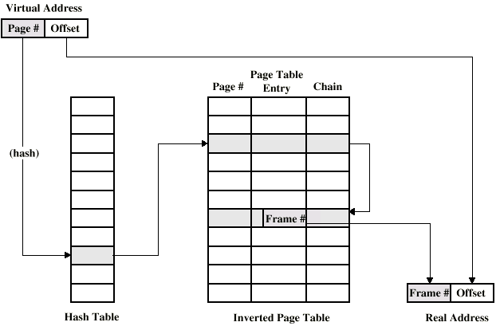
Page Table Structure

Slide 42
Translation Lookaside Buffer
Every virtual memory reference causes two physical memory access
  Fetch page table entry
  Fetch data
Use special cache for page table
  TLB

Slide 43
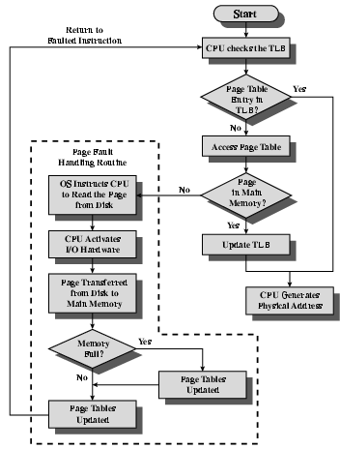
TLB Operation

Slide 44
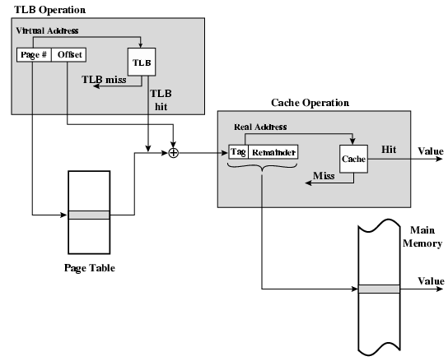
TLB and Cache Operation

Slide 45
Segmentation
Paging is not (usually) visible to the programmer
Segmentation is visible to the programmer
Usually different segments allocated to program and data
May be a number of program and data segments

Slide 46
Advantages of Segmentation
Simplifies handling of growing data structures
Allows programs to be altered and recompiled independently, without re-linking and re-loading
Lends itself to sharing among processes
Lends itself to protection
Some systems combine segmentation with paging

Slide 47
Pentium II
Hardware for segmentation and paging
Unsegmented unpaged
  virtual address = physical address
  Low complexity
  High performance
Unsegmented paged
  Memory viewed as paged linear address space
  Protection and management via paging
  Berkeley UNIX
Segmented unpaged
  Collection of local address spaces
  Protection to single byte level
  Translation table needed is on chip when segment is in memory
Segmented paged
  Segmentation used to define logical memory partitions subject to access control
  Paging manages allocation of memory within partitions
  Unix System V

Slide 48
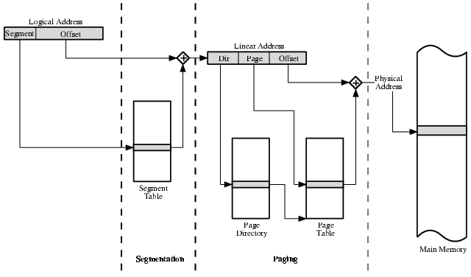
Pentium II Address Translation Mechanism

Slide 49
Pentium II Segmentation
Each virtual address is 16-bit segment and 32-bit offset
2 bits of segment are protection mechanism
14 bits specify segment
Unsegmented virtual memory 2³² = 4Gbytes
Segmented 2⁴⁶=64 terabytes
  Can be larger – depends on which process is active
  Half (8K segments of 4Gbytes) is global
  Half is local and distinct for each process

Slide 50
Pentium II Protection
Protection bits give 4 levels of privilege
  0 most protected, 3 least
  Use of levels software dependent
  Usually level 3 for applications, level 1 for O/S and level 0 for kernel (level 2 not used)
  Level 2 may be used for apps that have internal security e.g. database
  Some instructions only work in level 0

Slide 51
Pentium II Paging
Segmentation may be disabled
  In which case linear address space is used
Two level page table lookup
  First, page directory
    1024 entries max
    Splits 4G linear memory into 1024 page groups of 4Mbyte
    Each page table has 1024 entries corresponding to 4Kbyte pages
    Can use one page directory for all processes, one per process or mixture
    Page directory for current process always in memory
  Use TLB holding 32 page table entries
  Two page sizes available 4k or 4M

Slide 52
PowerPC Memory Management Hardware
32 bit – paging with simple segmentation
  64 bit paging with more powerful segmentation
Or, both do block address translation
  Map 4 large blocks of instructions & 4 of memory to bypass paging
  e.g. OS tables or graphics frame buffers
32 bit effective address
  12 bit byte selector
    =4kbyte pages
  16 bit page id
    64k pages per segment
  4 bits indicate one of 16 segment registers
    Segment registers under OS control

Slide 53
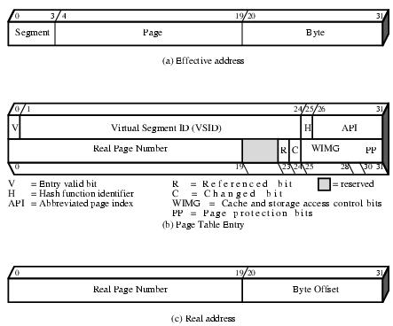
PowerPC 32-bit Memory Management Formats

Slide 54
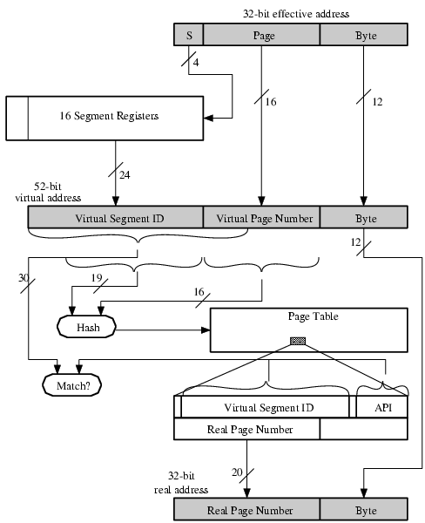
PowerPC 32-bit Address Translation

Slide 55
Required Reading
Stallings chapter 8
Stallings, W. Operating Systems, Internals and Design Principles, Prentice Hall 1998
Loads of Web sites on Operating Systems

